Slide 1
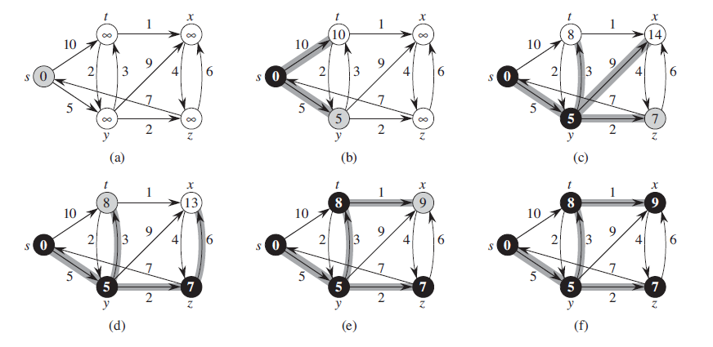
Dijkstra’s Algorithm
Find The Shortest Path
Michael Uftring
Indiana University
I-590 Data Visualization
Fall, 2017
http://www.codebytes.in/2014/08/dijkstras-algorithm-implementation-in.html

Slide 2
Introduction
What is this project about?
What will be presented?

Slide 3
Objectives
Purpose
To explore and visualize Dijkstra’s Shortest Path algorithm
Motivation
Mid-term was a data analysis project
I wanted to undertake a dev-type project
Dust off my memory of something I learned in undergrad
Work on something in an area that I have a lot of interest
graph theory, networks, complex systems

Slide 4
Dijkstra’s Algorithm
What is it?
An algorithm for finding the shortest path between nodes in a graph
https://en.wikipedia.org/wiki/Dijkstra%27s_algorithm

Slide 5
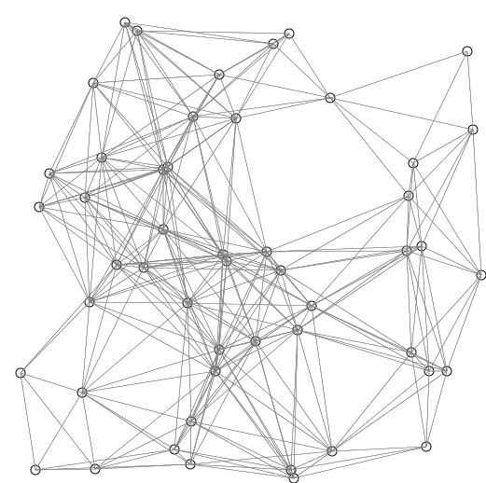
Dijkstra’s Algorithm
How does it work?
picks the unvisited node with the lowest distance,
calculates the distance through it to each unvisited neighbor
updates the neighbor's distance if smaller
https://commons.wikimedia.org/w/index.php?curid=54537901

Slide 6
Dijkstra’s Algorithm
Why is this interesting and important?
Networks are everywhere
Finding the shortest path in a graph (network) is important in many fields of study
Discovering relationships which may not be readily apparent
Optimization

Slide 7
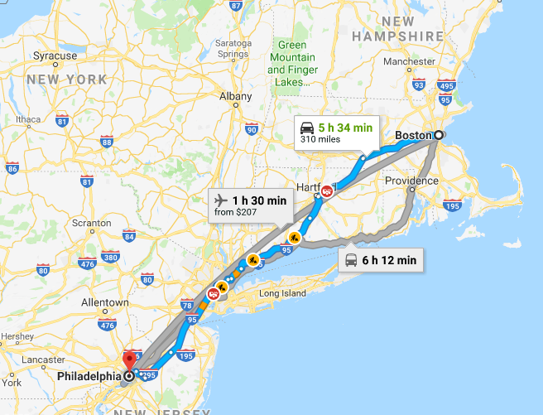
Dijkstra’s Algorithm
Where is this (or related algorithms) used?
Routing computer network traffic
Transportation networks
e.g., roads, trains, airplanes
VLSI design
Exploiting arbitrage opportunities

Slide 8
Dijkstra’s Algorithm
Maybe a more accurate description would be: finding the most optimal path
Consider a network with more than one path from the source to the destination
“short” implies distance (perhaps the fewest hops?)
The path with least cost may be longer in terms of hops
The sum total of the edge weights of each hop is less than that of perhaps “shorter” paths

Slide 9
Related Work
Search the Internet for: visualizing dijkstra's algorithm
Google reports “About 86,800 results”
Some are visual explanations of Dijkstra’s algorithm
Some serve specific needs (i.e., gaming)
Just 3 will be showcased here (in the interest of time, and doing justice to the implementers)

Slide 10
David Galles, University of San Francisco
Description:
An animated visualization of Dijkstra’s algorithm for randomly generated graphs
https://www.cs.usfca.edu/~galles/visualization/Dijkstra.html

Slide 11
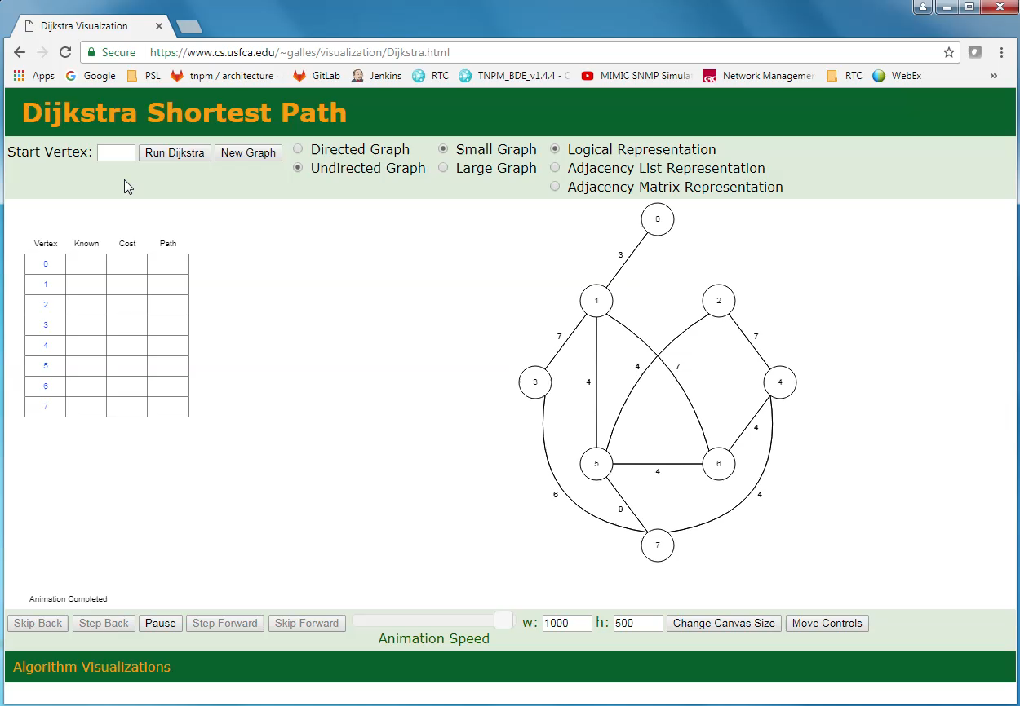
Demo

Slide 12
Assessment
Likes
Dislikes
The animated execution
The tabulated results
Stepping capability
Only operates on randomly generated graphs

Slide 13
Lisa Velden, Technischen Universität München
Description
A comprehensive learning experience, with exercises
Description of Dijkstra’s algorithm
Interactive graph exploration
https://www-m9.ma.tum.de/graph-algorithms/spp-dijkstra/index_en.html

Slide 14
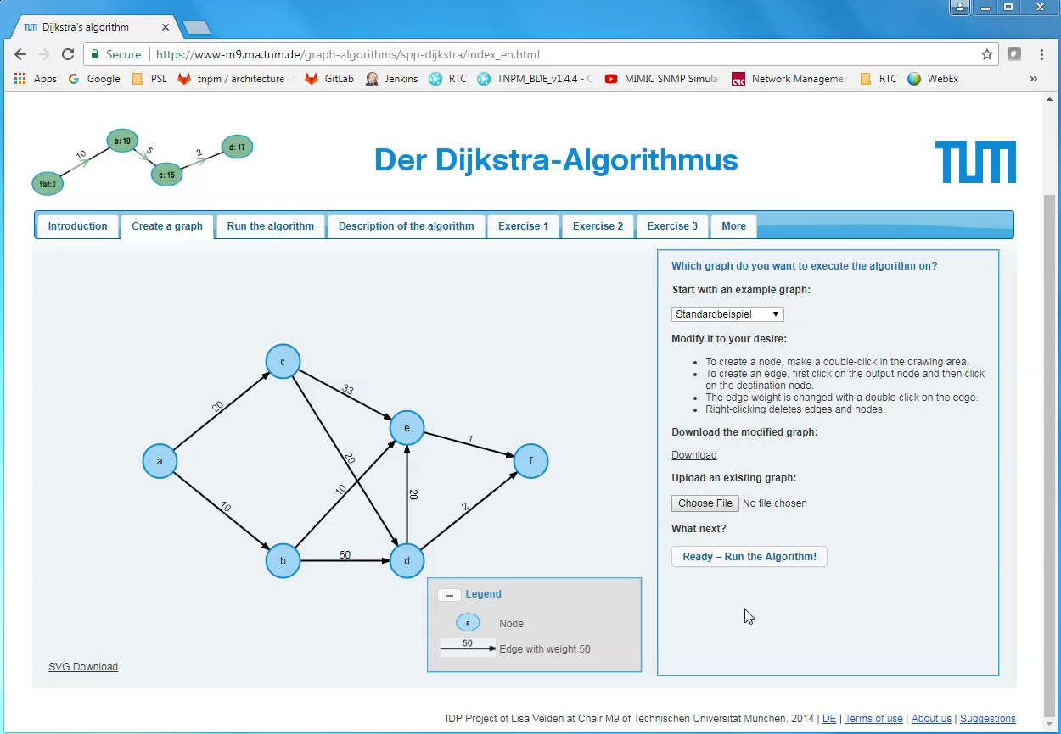
Demo

Slide 15
Assessment
Likes
Dislikes
The animated execution
Interactive graph editing
Upload/Download capability
Graph file format

Slide 16
GraphOnline.ru
Description:
An interactive graph editor
With several graph algorithms to choose from
With zoom in/out capability
http://graphonline.ru/en/

Slide 17
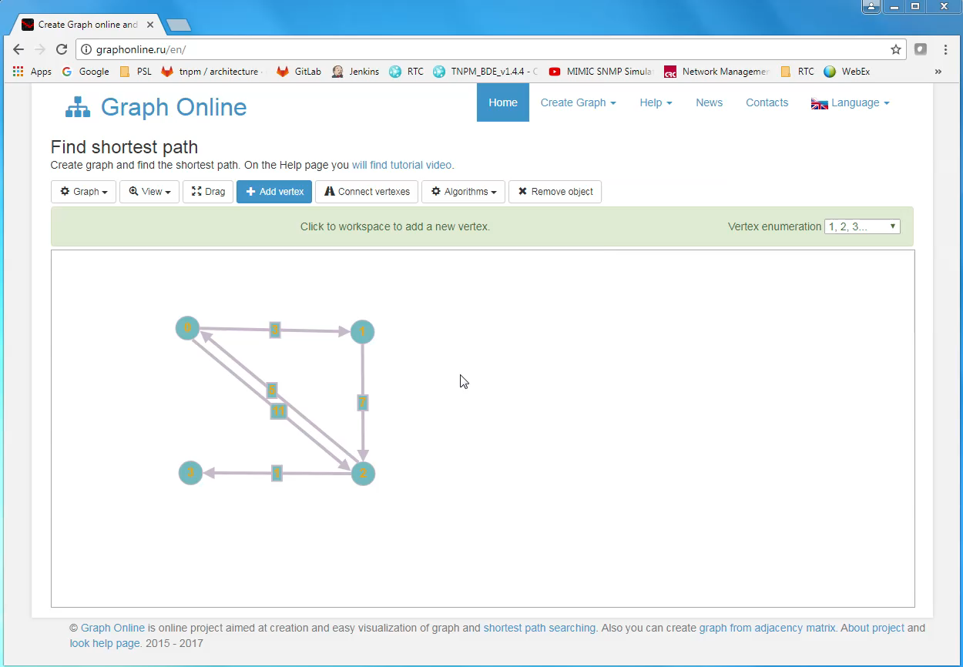
Demo

Slide 18
Assessment
Likes
Dislikes
Interactive graph editing
Good selection of algorithms
Dijkstra’s
Floyd-Warshall
Find Connected Components
Ability to zoom in/out
Edge editing is “clunky”
Save is to graphonline.ru web site
No Upload/Download of graph definitions

Slide 19
Honorable Mentions
Matthew Wigginton Conway
http://projects.indicatrix.org/dijkstra.js/
VisuAlgo.net
https://visualgo.net/en/sssp
Xueqiao (Joe) Xu, Google
https://qiao.github.io/PathFinding.js/visual/

Slide 20
Summary
There are some very good resources on the web
It is easy to derive motivation from existing examples
Some are very well thought out, and showcase very well
None that I explored provide everything that I’m looking for

Slide 21
Project Details
Now that we know about Dijkstra’s algorithm
And we have seen some existing visualizations
What did I do here?

Slide 22
Recall Objectives and Motivation
Explore Dijkstra’s Shortest Path algorithm
Because I needed to dust off my memory of something I learned in undergrad
Visualize Dijkstra’s Shortest Path algorithm
but not just a static visualization, this should be interactive
This will require some exploration first, before jumping into an implementation

Slide 23
Exploring Dijkstra’s Algorithm
Jupyter Notebook
Python implementation
http://www.gilles-bertrand.com/2014/03/dijkstra-algorithm-python-example-source-code-shortest-path.html

Slide 24
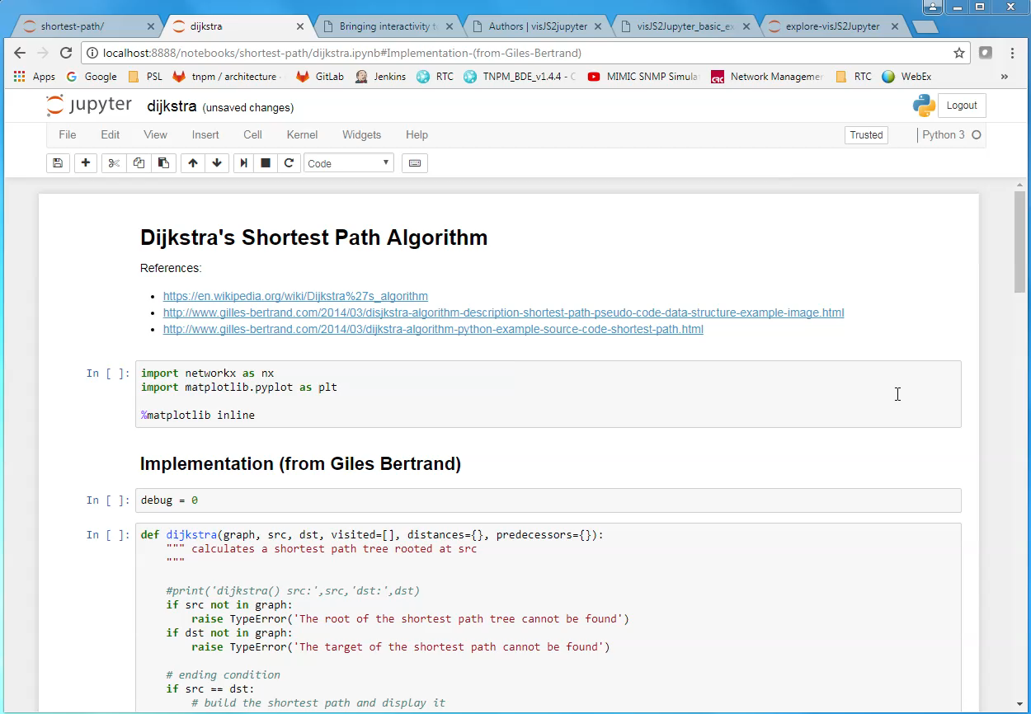
Jupyter Notebook (code)

Slide 25
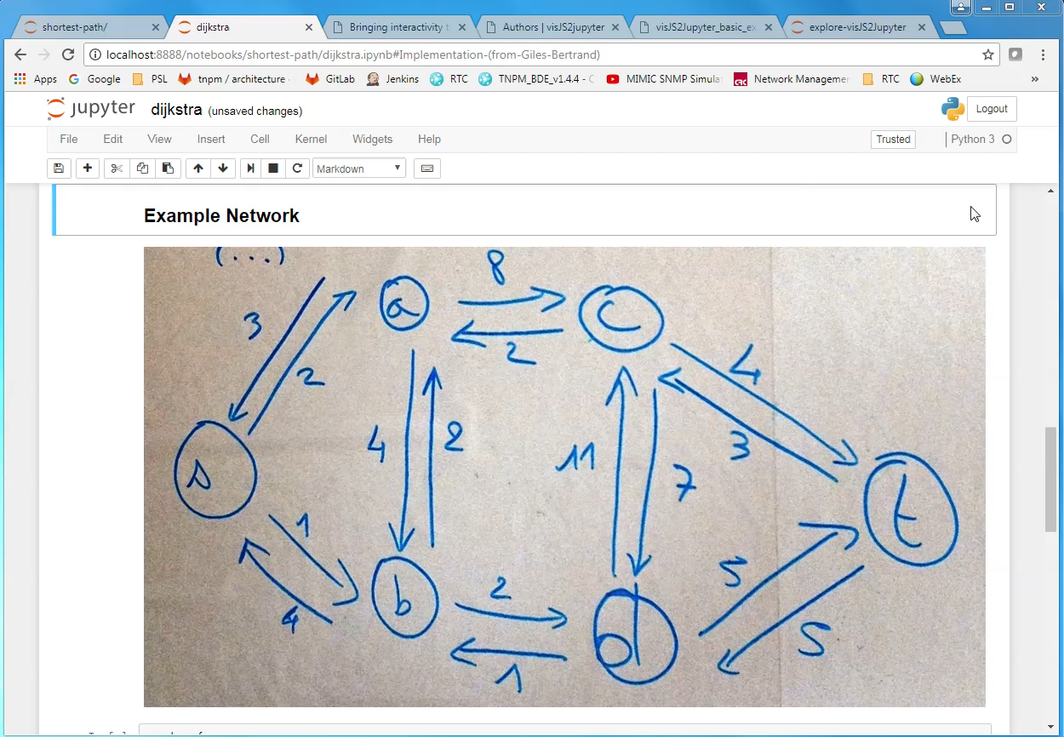
Jupyter Notebook (execution)

Slide 26
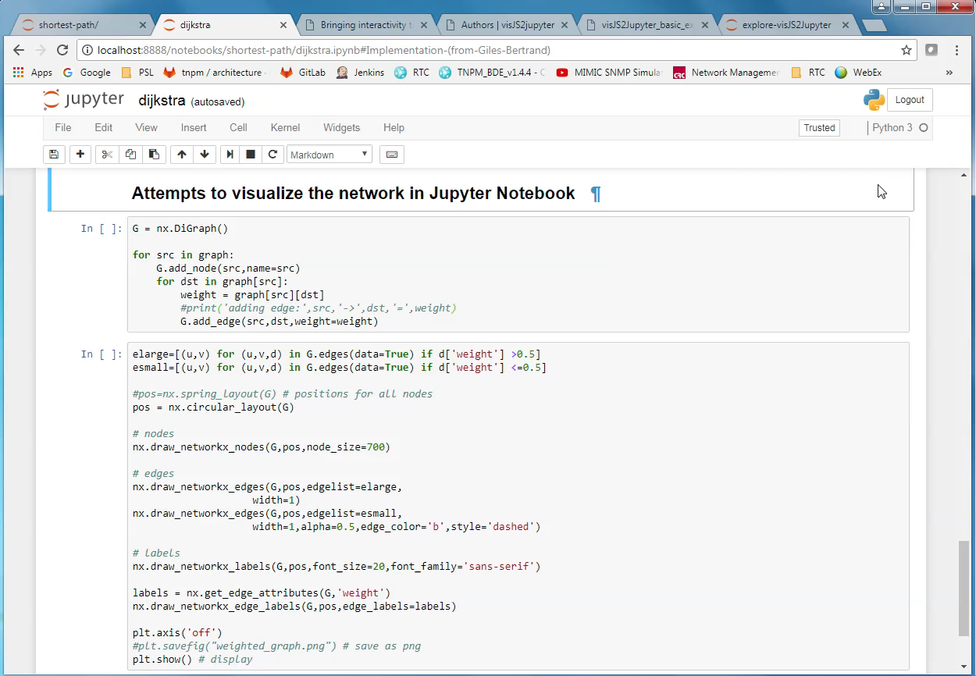
Jupyter Notebook (visualization, try #1)

Slide 27
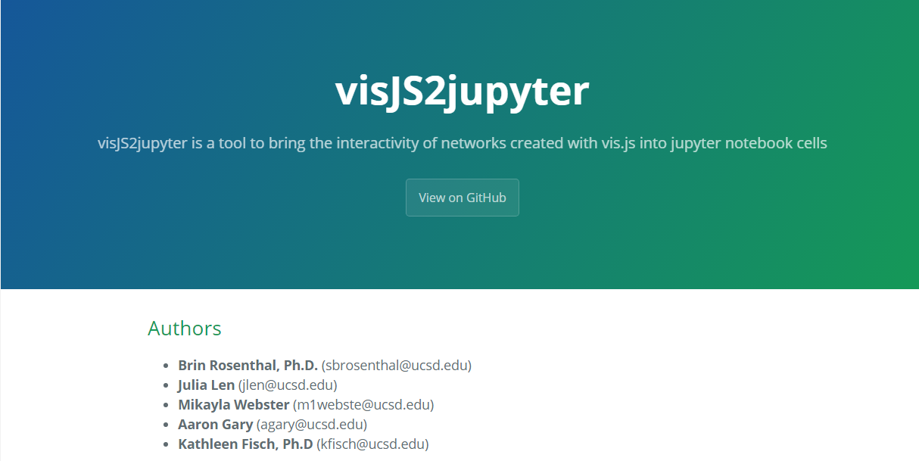
Enter: visJS2jupyter
“a tool to bring the interactivity of networks created with vis.js into jupyter notebook cells”
https://ucsd-ccbb.github.io/visJS2jupyter/
vis.js
A dynamic, browser based visualization library.
Created by a research group at
The Center for Computational Biology & Bioinformatics
Univ. California, San Diego

Slide 28
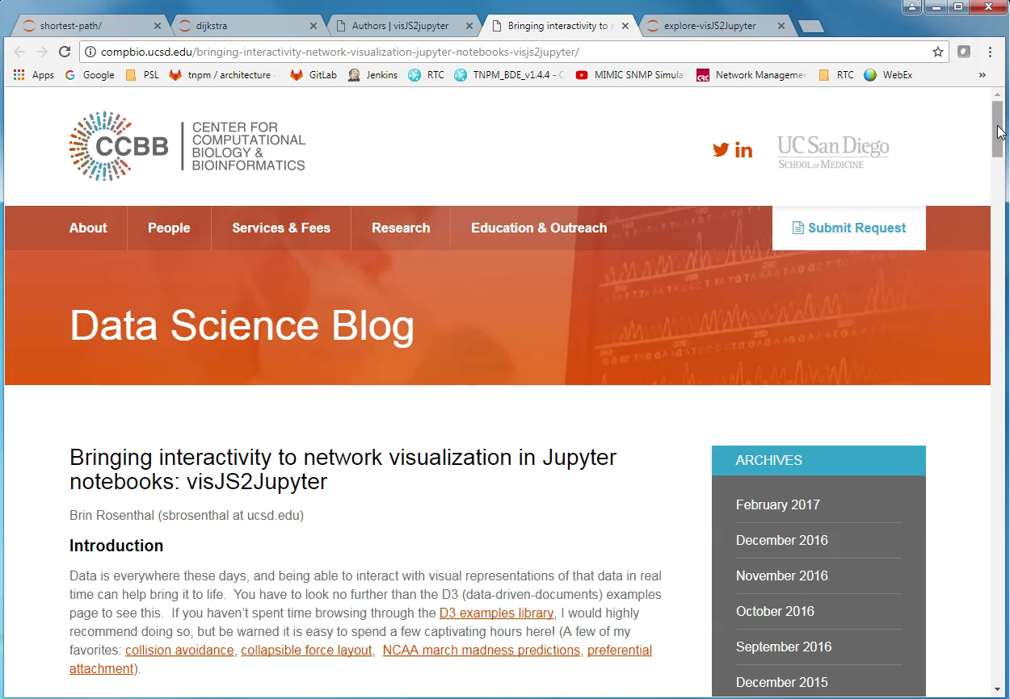
visJS2jupyter (example)

Slide 29
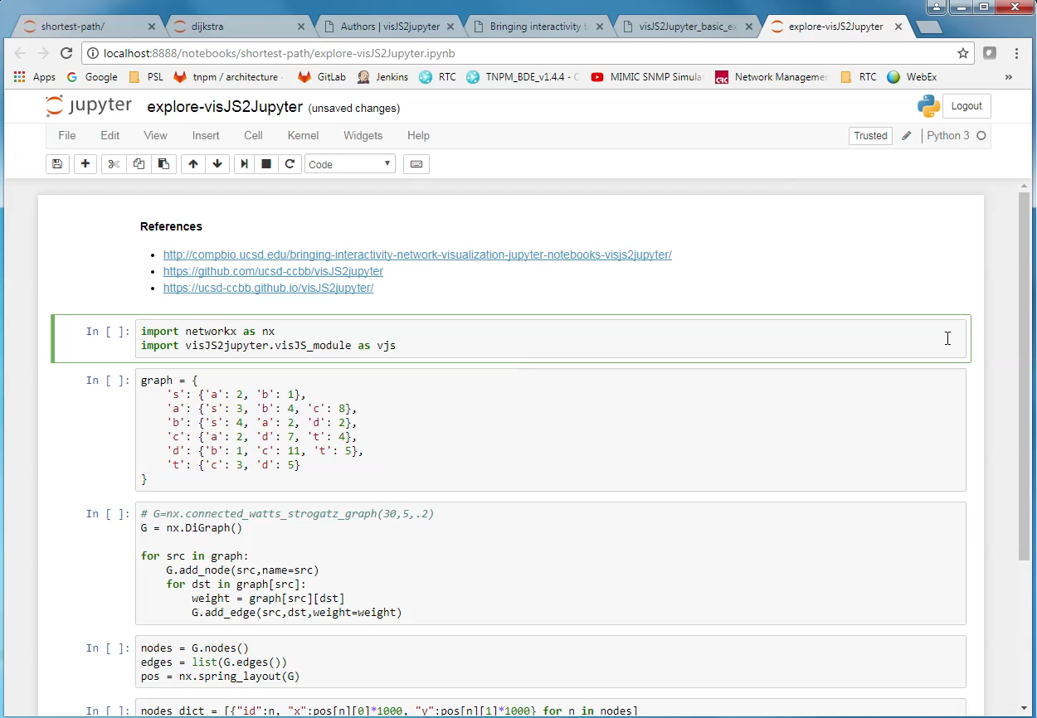
Jupyter Notebook (visualization, try #2)

Slide 30
Exploration – Done!
The Jupyter Notebook exercises helped with
Re-learning Dijkstra’s algorithm
Reading, in depth, some existing code
Stepping through the code with “debug” statements
Exploring some shortest path examples
To reinforce the learning exercises, and solidify understanding
Exploring how to visualize a network
NetworkX + Matplotlib
vis2JSjupyter

Slide 31
Now, on to more interesting things!
Explore and visualize Dijkstra’s Shortest Path algorithm
undertake a dev-type project
work on something with a lot of interest
Time for a D3.js web application

Slide 32
Implementation Objectives
Network described in a file
JSON format
The format used in class is simple and clear
It works seamlessly with D3.js
User Experience
Select file to load
Choose source and destination nodes
Click “Run”
Build this to be extensible, and usable in the future
e.g., in Network Science course (Spring, 2018)
Present more network attributes
Interactively create/modify/save graphs

Slide 33
Network JSON Format
{
"nodes": [
{"id": "a", "group": 1},
{"id": "b", "group": 1},
{"id": "c", "group": 1},
{"id": "d", "group": 1},
{"id": "s", "group": 1},
{"id": "t", "group": 1}
],
"links": [
{"source": "s", "target": "a", "value": 2},
{"source": "s", "target": "b", "value": 1},
{"source": "a", "target": "s", "value": 3},
{"source": "a", "target": "b", "value": 4},
{"source": "a", "target": "c", "value": 8},
{"source": "b", "target": "s", "value": 4},
{"source": "b", "target": "a", "value": 2},
{"source": "b", "target": "d", "value": 2},
{"source": "c", "target": "a", "value": 2},
{"source": "c", "target": "d", "value": 7},
{"source": "c", "target": "t", "value": 4},
{"source": "d", "target": "b", "value": 1},
{"source": "d", "target": "c", "value": 11},
{"source": "d", "target": "t", "value": 5},
{"source": "t", "target": "c", "value": 3},
{"source": "t", "target": "d", "value": 5}
]
}

Slide 34
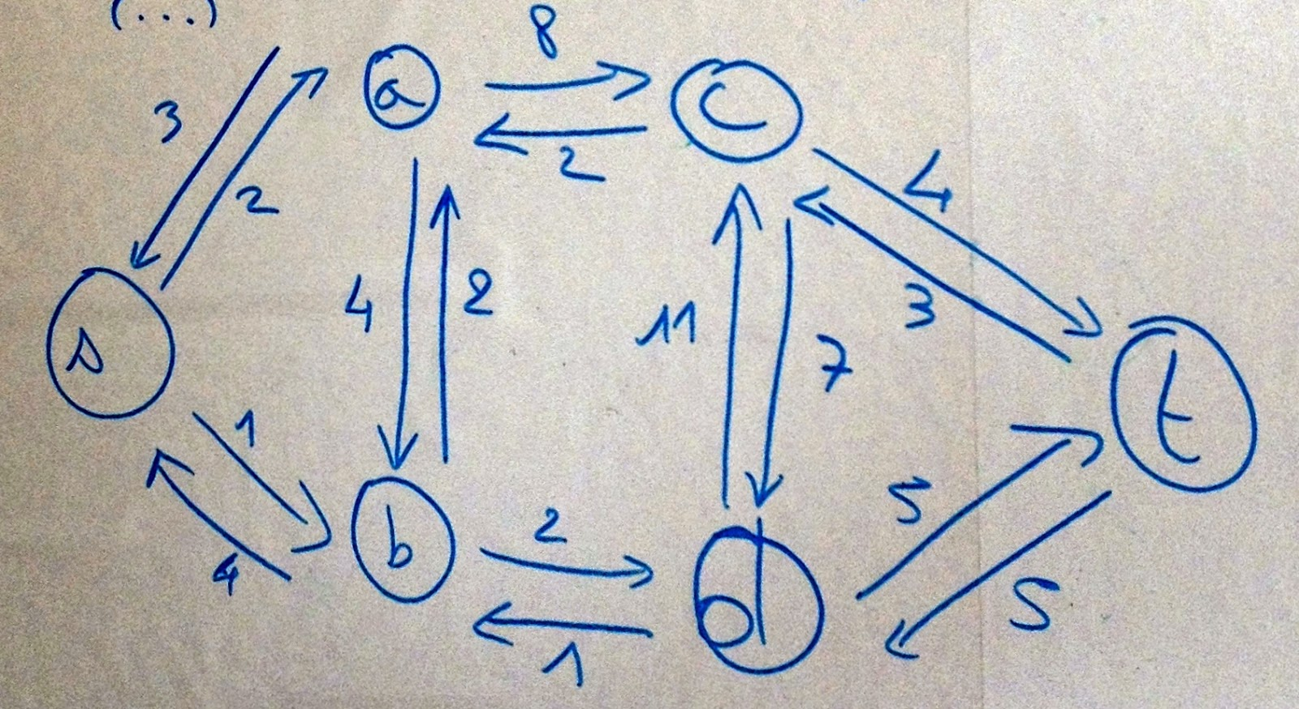
Example Network
Gilles Bertrand example
Find shortest path from ‘s’ to ‘t’
http://www.gilles-bertrand.com/2014/03/disjkstra-algorithm-description-shortest-path-pseudo-code-data-structure-example-image.html

Slide 35
Coding Dijkstra’s algorithm in JavaScript
Python and JavaScript have similar syntax
Porting Gilles Bertrand’s implementation was straightforward
A few sticking points:
There are some differences in how Array and Dictionary work
JavaScript Array does not have ‘in’ operator
JavaScript Array append is called push()
… and there is corresponding pop(), which permits arrays to work like stacks

Slide 36
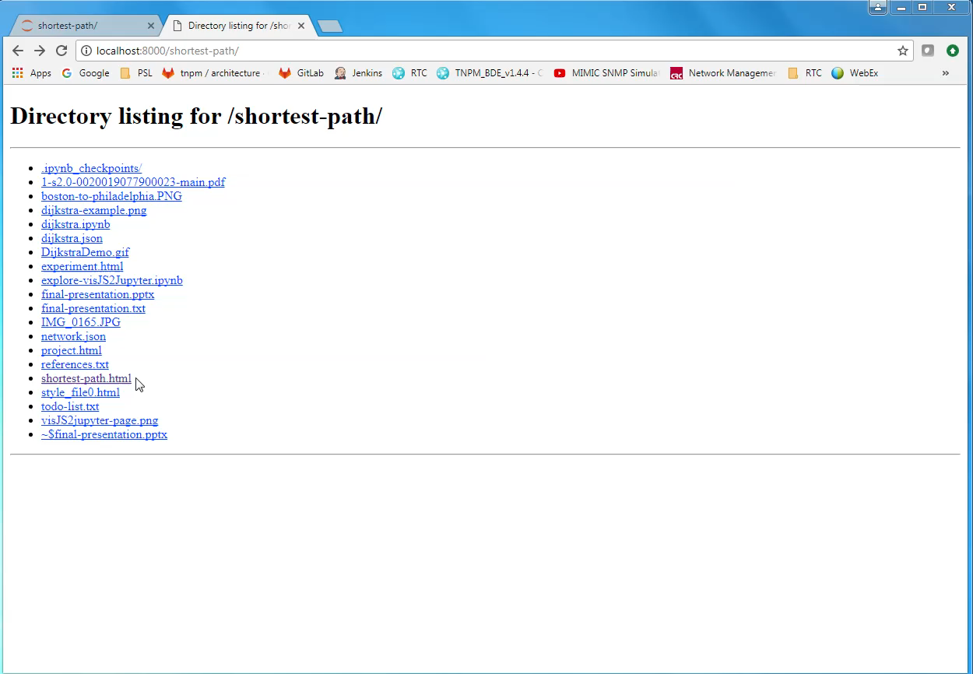
Demo (loading a graph)

Slide 37
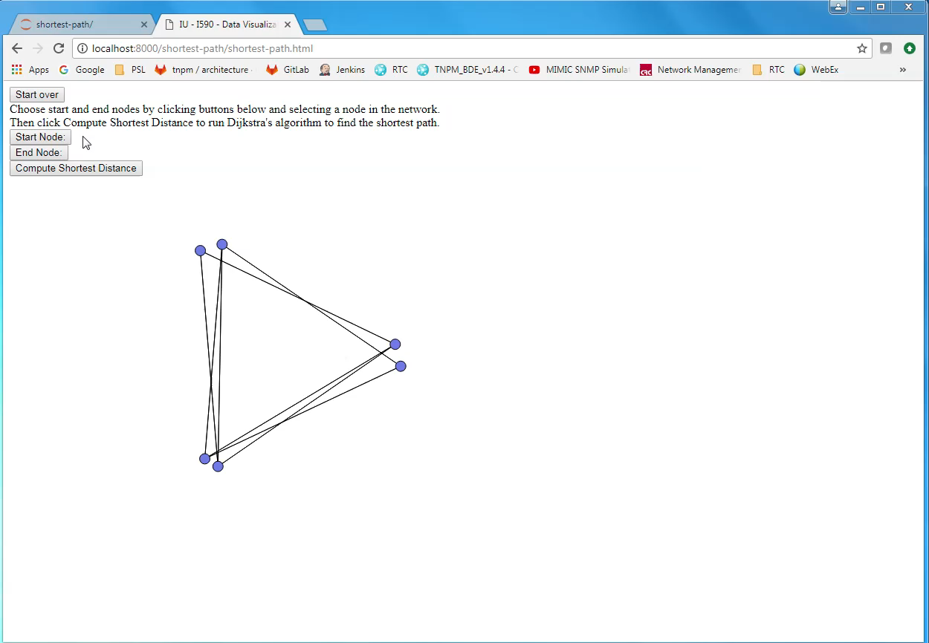
Demo (finding the shortest path)

Slide 38
Lessons Learned
I’m not a web application developer (yet!)
This was my first venture into making any kind of web application
“You don’t know what you don’t know… …until you try something new.”
Jupyter Notebook is awesome!
People are doing all sorts of things with Jupyter
It is not just for summarizing terabytes of data and making bar charts

Slide 39
What’s Next?
Improve the user experience
Additional capability
Really would like to animate the execution of Dijkstra’s algorithm
This was one of the nicest features of several existing implementations
Make it more resilient
… to invalid user requests
… to “abnormal” network definitions

Slide 40
Conclusion
D3 made this project relatively “easy”
Several concepts and code from course assignments were reused
D3 provides a lot of capability out of the box
Some things are easy with D3
Some things are not straightforward with D3
There are a lot of D3 resources
d3js.org, bl.ocks.org, Stack Overflow, Twitter, blogs, books, …
The community is generally very welcoming and helpful

